Slide 1
ECOSYSTEM

Slide 2
Ecosystem
Ecosystem is a functional unit of nature.
In ecosystem, living organisms interact among themselves and also with the surrounding physical environment.
Ecosystem varies greatly in size from a small pond to a large forest or a sea.
Many ecologists regard the entire biosphere as a global ecosystem, as a composite of a local ecosystems on Earth.
Since global ecosystem is too big and complex to be studied at one time, it is convenient to divide it into two basic categories, namely
the terrestrial (Forest, grassland and desert ) and
the aquatic (pond, lake, wetland, river and estuary).
Crop fields and an aquarium may also be considered as man-made ecosystems.

Slide 3
Objectives of the chapter on ecosystem
To study the structure of the ecosystem
To study the input (productivity), energy flow (food chain/web, nutrient cycling) and the output (degradation and energy loss).

Slide 4
Structure and function of ecosystem
Interaction of biotic and abiotic components result in a physical structure that is characteristic for each type of ecosystem.
Identification and enumeration of plant and animal species of an ecosystem gives its species composition.
Stratification is the vertical distribution of different species occupying different levels. For example, trees occupy top vertical strata or layer of a forest, shrubs the second and herbs and grasses occupy the bottom layers.
The components of the ecosystem are seen to function as a unit when you consider the following aspects:
Productivity;
Decomposition;
Energy flow; and
Nutrient cycling.

Slide 5
Pond as an aquatic ecosystem
A pond is a shallow water body in which all the four basic components of an ecosystem (Productivity; Decomposition; Energy flow; and Nutrient cycling) are well exhibited.
The abiotic component is the water with all the dissolved inorganic and organic substances and the rich soil deposit at the bottom of the pond.
The solar input, the cycle of temperature, day length and other climatic conditions regulate the rate of function of the entire pond.
The autotrophic components include the phytoplankton, some algae and the floating, submerged and marginal plants found at the edges.
The consumers are represented by the zooplankton, the free swimming and bottom dwelling forms.
The decomposers are the fungi, bacteria and flagellates especially abundant in the bottom of the pond.

Slide 6
Pond as an aquatic ecosystem
A pond system performs all the functions of any ecosystem and of the biosphere as a whole, i.e.,
conversion of inorganic into organic material with the help of the radiant energy of the sun by the autotrophs;
consumption of the autotrophs by heterotrophs;
decomposition and mineralisation of the dead matter to release them back for reuse by the autotrophs,
these event are repeated over and over again.
There is unidirectional movement of energy towards the higher trophic levels and its dissipation and loss as heat to the environment.

Slide 7
PRODUCTIVITY
A constant input of solar energy is the basic requirement for any ecosystem to function and sustain.
Primary production is the amount of biomass or organic matter produced per unit area over a time period by plants during photosynthesis.
Primary production is expressed in terms of weight (g m^{–2}) or energy (kcal m^{–2}).
Productivity is the rate of biomass production.
Productivity is expressed in terms of gm^{–2} yr ^{–1} or (kcal m^{–2}) yr^{–1} to compare the productivity of different ecosystems.
Productivity can be divided into
Gross Primary Productivity (GPP) and
Net Primary Productivity (NPP).

Slide 8
PRODUCTIVITY
Gross primary productivity of an ecosystem is the rate of production of organic matter during photosynthesis.
A considerable amount of GPP is utilised by plants in respiration.
Net primary productivity (NPP) is the gross primary productivity minus respiration losses (R).
NPP = GPP – R
Net primary productivity is the available biomass for the consumption to heterotrophs (herbiviores and decomposers).
Secondary productivity is the rate of formation of new organic matter by consumers.
Primary productivity depends on
the plant species inhabiting a particular area.
a variety of environmental factors,
availability of nutrients and
photosynthetic capacity of plants.

Slide 9
DECOMPOSITION
Decomposition is the process of break down complex organic matter into inorganic substances like carbon dioxide, water and nutrients by decomposer.
Detritus is the raw material for decomposition constituted by dead plant remains (such as leaves, bark, flowers) and dead remains of animals, including fecal matter.
The important steps in the process of decomposition are
fragmentation,
leaching,
catabolism,
humification
and mineralisation.
Notes:
Earthworm is the farmer’s ‘friend’ as it help in the breakdown of complex organic matter as well as in loosening of the soil.

Slide 10
Steps in the process of decomposition
Fragmentation is the process where detritivores (e.g., Earthworm) break down detritus into smaller particles.
Leaching is the process by which water soluble inorganic nutrients go down into the soil horizon and get precipitated as unavailable salts.
Catabolism is the enzymatic process by which degraded detritus is converted into simpler inorganic substances.
Fragmentation, leaching and catabolism in decomposition operate simultaneously on the detritus.
Humification process of formation/accumulation of a nutrient rich humus (dark coloured amorphous substance) that is highly resistant to microbial action and undergoes decomposition at an extremely slow rate.
Mineralisation is the process by which humus is further degraded by some microbes and release of inorganic nutrients.

Slide 11
Enlist some factors affecting decomposition
Temperature
soil moisture content
Availability of microbes.
Availability of Oxygen

Slide 12
DECOMPOSITION
Decomposition is largely an oxygen-requiring process.
The rate of decomposition is controlled by chemical composition of detritus and climatic factors(Temperature and soil moisture).
Decomposition rate is
slower if detritus is rich in lignin and chitin, and
quicker, if detritus is rich in nitrogen and water-soluble substances like sugars.
Temperature and soil moisture are the most important climatic factors that regulate decomposition through their effects on the activities of soil microbes.
Warm and moist environment favour decomposition
Low temperature and anaerobiosis inhibit decomposition resulting in build up of organic materials.

Slide 13
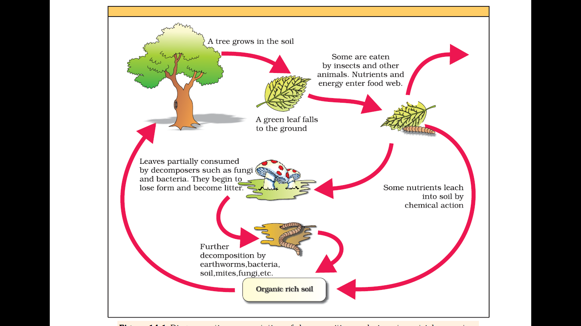
Figure Diagrammatic representation of decomposition cycle in a terrestrial ecosystem

Slide 14
ENERGY FLOW
Sun is the only source of energy for all ecosystems on Earth, except for the deep sea hydro-thermal ecosystem.
<50% of the incident solar radiation is photosynthetically active radiation (PAR).
Plants and photosynthetic and chemosynthetic bacteria (autotrophs) fix suns’ radiant energy to make food from simple inorganic materials.
Plants capture only 2-10 per cent of the PAR and this small amount of energy sustains the entire living world.
How the solar energy captured by plants flows through different organisms of an ecosystem?
All organisms are dependent for their food on producers, either directly or indirectly.
There is unidirectional flow of energy from the sun to producers and then to consumers by following first law of thermodynamics.
They need a constant supply of energy to synthesise the molecules they require, to counteract the universal tendency toward increasing disorderliness.

Slide 15
Answer the following questions
Define producers and consumers (heterotrophs) with an example each.
Enlist the major primary producer in a terrestrial ecosystem
Answer: Herbaceous and woody plants.
Enlist the major primary producers in an aquatic ecosystem
Answer: Phytoplankton, algae and higher plants.
What is food chains and webs?
What is herbivores, carnivores and omnivores?

Slide 16
ENERGY FLOW
The green plant in the ecosystem terminology are called producers.
In a terrestrial ecosystem, major producers are herbaceous and woody plants.
Likewise, primary producers in an aquatic ecosystem are various species like phytoplankton, algae and higher plants.
food chains and webs that exit in nature.
Starting from the plants (or producers) food chains or rather webs are formed such that an animal feeds on a plant or on another animal and in turn is food for another.
The chain or web is formed because of this interdependency. No energy that is trapped into an organism remains in it for ever.
The energy trapped by the producer, hence, is either passed on to a consumer or the organism dies.
Death of organism is the beginning of the detritus food chain/web.
All animals depend on plants (directly or indirectly) for their food needs and are hence called consumers (heterotrophs).

Slide 17
ENERGY FLOW
If they feed on the producers, the plants, they are called primary consumers, and if the animals eat other animals which in turn eat the plants (or their produce) they are called secondary consumers.
Likewise, you could have tertiary consumers too.
Primary consumers are herbivores (insects, birds and mammals) in terrestrial ecosystem and molluscs in aquatic ecosystem.
The consumers that feed on these herbivores are carnivores, or more correctly primary carnivores (though secondary consumers).
Those animals that depend on the primary carnivores for food are labelled secondary carnivores.
Omnivores like cockroaches, crows, etc are both herbivores and carnivores.

Slide 18
ENERGY FLOW
A simple grazing food chain (GFC) is depicted below:
Grass (Producer) Goat (Primary Consumer) Man (Secondary consumer)
The detritus food chain (DFC) begins with dead organic matter.
DFC is made up of decomposers which are heterotrophic organisms, mainly fungi and bacteria.
Decomposers meet their energy and nutrient requirements by degrading dead organic matter or detritus. These are also known as saprotrophs (sapro: to decompose).
Decomposers secrete digestive enzymes that breakdown dead and waste materials into simple, inorganic materials, which are subsequently absorbed by them.

Slide 19
ENERGY FLOW
In an aquatic ecosystem, GFC is the major conduit for energy flow.
In a terrestrial ecosystem, a much larger fraction of energy flows through the detritus food chain than through the GFC.
Detritus food chain may be connected with the grazing food chain at some levels: some of the organisms of DFC are prey to the GFC animals.
The natural interconnection of food chains make it a food web.
Organisms occupy a place in the natural surroundings or in a community according to their feeding relationship with other organisms.
Based on the source of their nutrition or food, organisms occupy a specific place in the food chain that is known as their trophic level.
Producers belong to the first trophic level, herbivores (primary consumer) to the second and carnivores (secondary consumer) to the third.

Slide 20
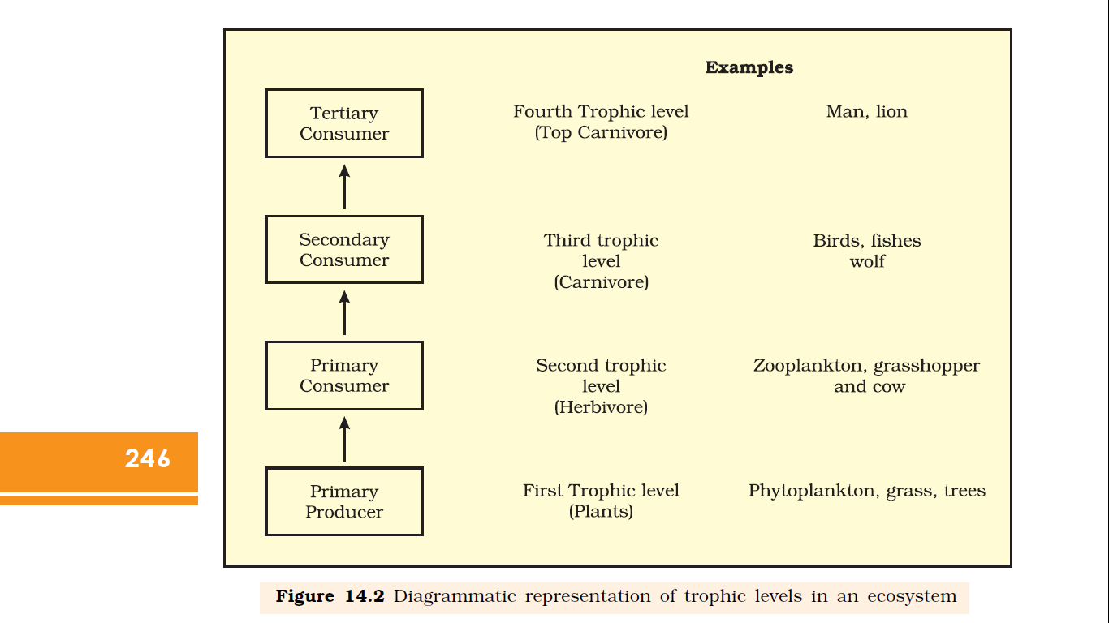
Figure Diagrammatic representation of trophic levels in an ecosystem

Slide 21
ENERGY FLOW
Amount of energy decreases at successive trophic levels.
When any organism dies it is converted to detritus or dead biomass that serves as an energy source for decomposers.
Organisms at each trophic level depend on those at the lower trophic level for their energy demands.
Each trophic level has a certain mass of living material at a particular time called as the standing crop.
The standing crop is measured as the mass of living organisms (biomass) or the number in a unit area.
The biomass of a species is expressed in terms of
fresh weight or
dry weight (more accurate).

Slide 22
ENERGY FLOW
The number of trophic levels in the grazing food chain is restricted as the transfer of energy follows 10 per cent law
only 10 per cent of the energy is transferred to each trophic level from the lower trophic level.
In nature, it is possible to have so many levels – producer, herbivore, primary carnivore, secondary carnivore in the grazing food chain.

Slide 23
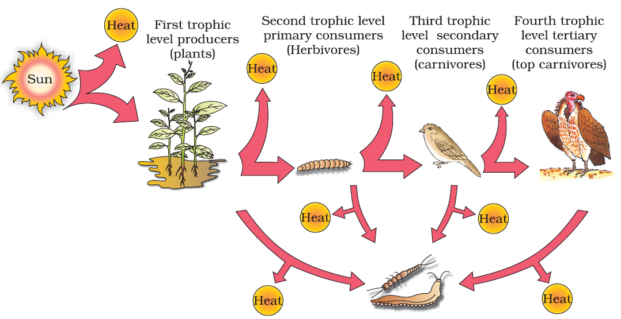
Figure Energy flow through different trophic levels

Slide 24
ECOLOGICAL PYRAMIDS
Expression of the food or energy relationship between organisms at different trophic level is called ecological pyramid i.e graphical representation in the form of pyramid of relation between producers and consumers in an ecosystem.
Ecological pyramids are expressed in terms of number, biomass or energy.
The base of each pyramid represents the producers (first trophic level) while the apex represents tertiary or top level consumer.
The three ecological pyramids that are usually studied are
pyramid of number;
pyramid of biomass and
pyramid of energy.
Notes:
Any calculations of energy content, biomass, or numbers has to include all organisms at that trophic level. No generalisations we make will be true if we take only a few individuals at any trophic level into account. Also a given organism may occupy more than one trophic level simultaneously. One must remember that the trophic level represents a functional level, not a species as such. A given species may occupy more than one trophic level in the same ecosystem at the same time; for example, a sparrow is a primary consumer when it eats seeds, fruits, peas, and a secondary consumer when it eats insects and worms. Can you work out how many trophic levels human beings function at in a food chain?

Slide 25
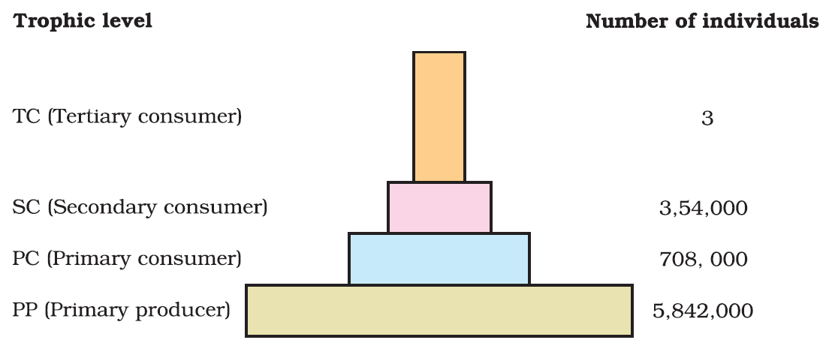
Figure Pyramid of numbers in a grassland ecosystem. Only three top-carnivores are supported in an ecosystem based on production of nearly 6 millions plants

Slide 26
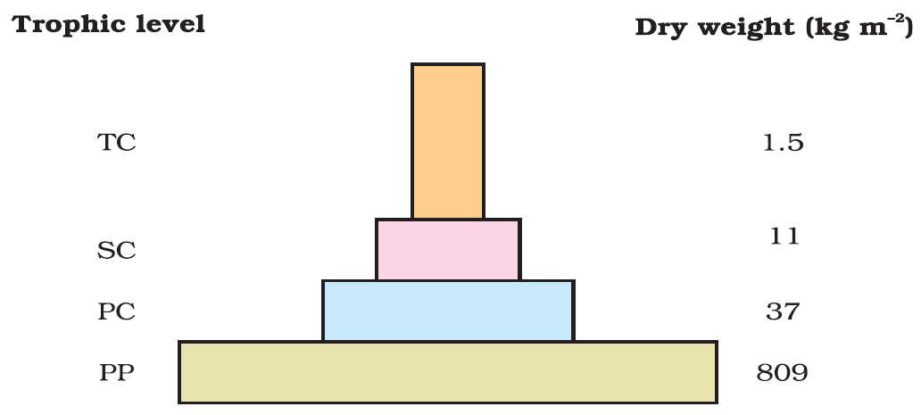
Figure Pyramid (upright) of biomass shows a sharp decrease in biomass at higher trophic levels

Slide 27
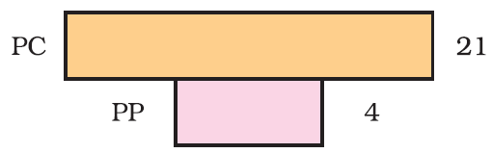
Figure Inverted pyramid of biomass; small standing crop of phytoplankton supports large standing crop of zooplankton

Slide 28
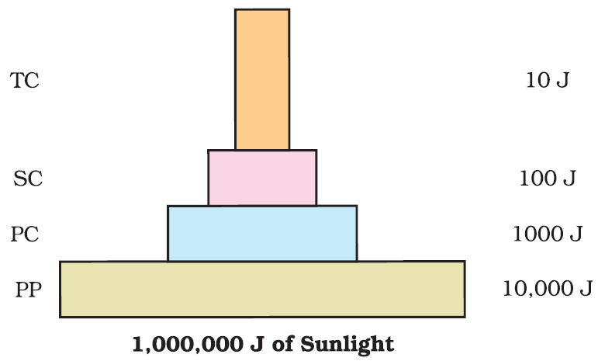
Figure An ideal pyramid of energy Primary producers convert only 1% of the energy in the sunlight available to them into NPP
Each bar in the energy pyramid indicates the amount of energy present at each trophic level in a given time or annually per unit area.

Slide 29
limitations of ecological pyramids
Ecological pyramids does not take into account the same species belonging to two or more trophic levels.
Ecological pyramids assumes a simple food chain, something that almost never exists in nature; it does not accommodate a food web.
Saprophytes are not given any place in ecological pyramids even though they play a vital role in the ecosystem.

Slide 30
ECOLOGICAL PYRAMIDS
All the pyramids (of number, of energy and biomass) are upright in all ecosystem i.e., producers are more in number, biomass and energy than the herbivores, and herbivores are more in number and biomass than the carnivores (Except some ecosystem).
Draw pyramids for following
Number of insects feeding on a big tree.
Number of small birds depending on the insects
Number of larger birds eating the smaller.
Biomass in sea.
The pyramid of biomass in sea is also generally inverted because the biomass of fishes far exceeds that of phytoplankton.
Pyramid of energy is always upright, can never be inverted, because when energy flows from a particular trophic level to the next trophic level, some energy is always lost as heat at each step.

Slide 31
ECOLOGICAL SUCCESSION
Try to define the following terms
Ecological succesion
Sere(s)
Seral stages or seral communities
Climax community
Pioneer species
xerophyte
Mesophyte
Hydrophyte

Slide 32
ECOLOGICAL SUCCESSION
An important characteristic of all communities is that composition and structure constantly change in response to the changing environmental conditions.
Change in composition and structure of community is orderly and sequential, parallel with the changes in the physical environment.
Changes in community lead to a community that is in near equilibrium with the environment and that is called a climax community.
The orderly and sequential, gradual and fairly predictable change in the species composition of a given area is called ecological succession.
During succession, some species colonise an area and their populations become more numerous, whereas populations of other species decline and even disappear.

Slide 33
ECOLOGICAL SUCCESSION
The entire sequence of communities that successively change in a given area are called sere(s).
The individual transitional communities are termed seral stages or seral communities.
In the successive seral stages there is a change in the diversity of species of organisms, increase in the number of species and organisms as well as an increase in the total biomass.
The present day communities in the world have come to be because of succession that has occurred over millions of years since life started on earth.
Actually succession and evolution would have been parallel processes at that time.

Slide 34
ECOLOGICAL SUCCESSION
Ecological succession may be;
Primary succession starts in areas where no living organisms ever existed, say bare rock; newly created pond or reservoir.
Secondary succession starts in areas where all the living organisms that existed have been destroyed, say abandoned farm lands; burned or cut forests and lands that have been flooded, etc.
The establishment of a new biotic community is generally slow.
Before a biotic community of diverse organisms can become established, there must be soil.
Depending mostly on the climate, it takes natural processes several hundred to several thousand years to produce fertile soil on bare rock.

Slide 35
ECOLOGICAL SUCCESSION
Secondary succession is faster than primary succession due to presence of some soil or sediment is present.
Ecological succession changes vegetation which in turn changes food and shelter for various types of animals leading to variation in numbers and types of animals and decomposers.
At any time during primary or secondary succession, natural or human induced disturbances (fire, deforestation, etc.), can convert a particular seral stage of succession to an earlier stage.
Natural or human disturbances also create new conditions that encourage some species and discourage or eliminate other species.

Slide 36
Succession of Plants
Succession of plants in aquatic/water habitat (or very wet areas) is called hydrach
Xerarch is succession of plants in very dry areas – succession of plants is called hydrach or xerarch, respectively.
Hydrarch succession takes place in wetter areas and the successional series progress from hydric to the mesic conditions.
Xerarch succession takes place in dry areas and the series progress from xeric to mesic conditions.
Both hydrarch and xerach successions lead to medium water conditions (mesic) -neither too dry (xeric) nor too wet (hydric).
The species that invade a bare area are called pioneer species.

Slide 37
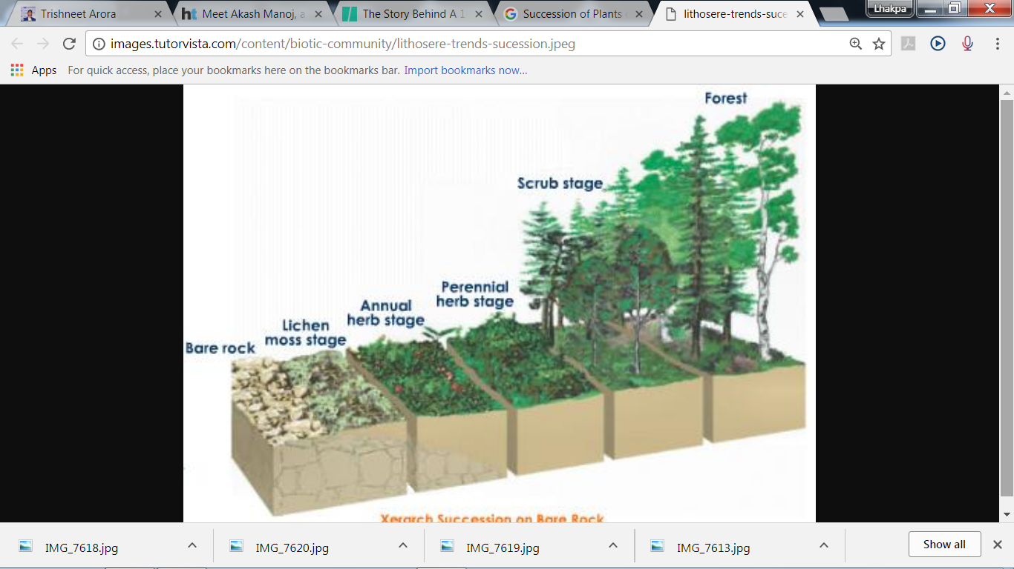
Succession of Plants on rocks
Xerophytic habitat gets converted into a mesophytic habitat
Notes:
Scrub: Dense vegetation consisting of stunted trees or bushes
Reed: Tall woody perennial grasses with hollow slender stems especially of the genera Arundo and Phragmites

Slide 38
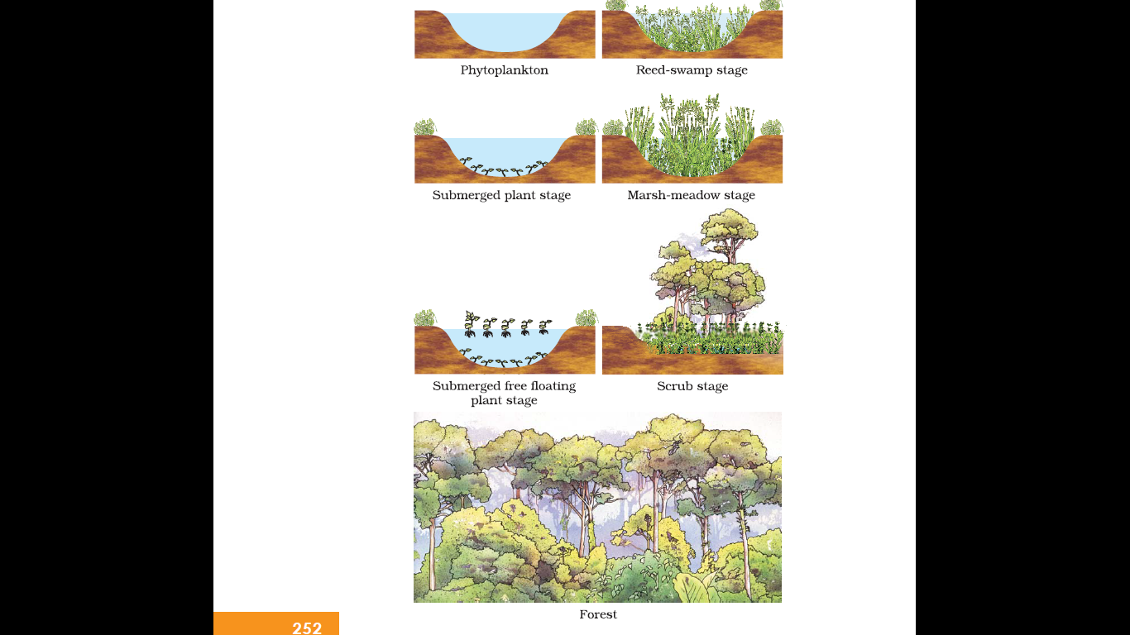
Figure Diagramatic representation of primary succession in water
Hydrophytic habitat gets converted into a mesophytic habitat

Slide 39
Nutrient Cycle/Biogeochemical Cycle(Bio: Living Organism, Geo: Rocks, Air, Water)
Organisms need a constant supply of nutrients to grow, reproduce and regulate various body functions.
Standing state is the amount of nutrients present in the soil at any given time.
Nutrient may be carbon, nitrogen, phosphorus, calcium, etc.
Different ecosystems have different standing crop in different season.
Nutrients are never lost from the ecosystems, they are recycled time and again indefinitely.
Nutrient cycling is the movement of nutrient elements through the various components of an ecosystem.
Nutrient cycles are of two types:
gaseous nutrient cycling and
sedimentary nutrient cycling.

Slide 40
Nutrient Cycling/Biogeochemical Cycles (Bio: Living Organism, Geo: Rocks, Air, Water)
The reservoir for gaseous nutrient cycle (e.g., nitrogen, carbon cycle) exists in the atmosphere.
The reservoir for the sedimentary nutrient cycle (e.g., sulphur and phosphorus cycle), the reservoir is located in Earth’s crust.
The function of the reservoir is to meet with the deficit which occurs due to imbalance in the rate of influx and efflux.
Soil, moisture, pH, temperature etc are environmental factors affecting release of nutrients in the atmosphere.

Slide 41
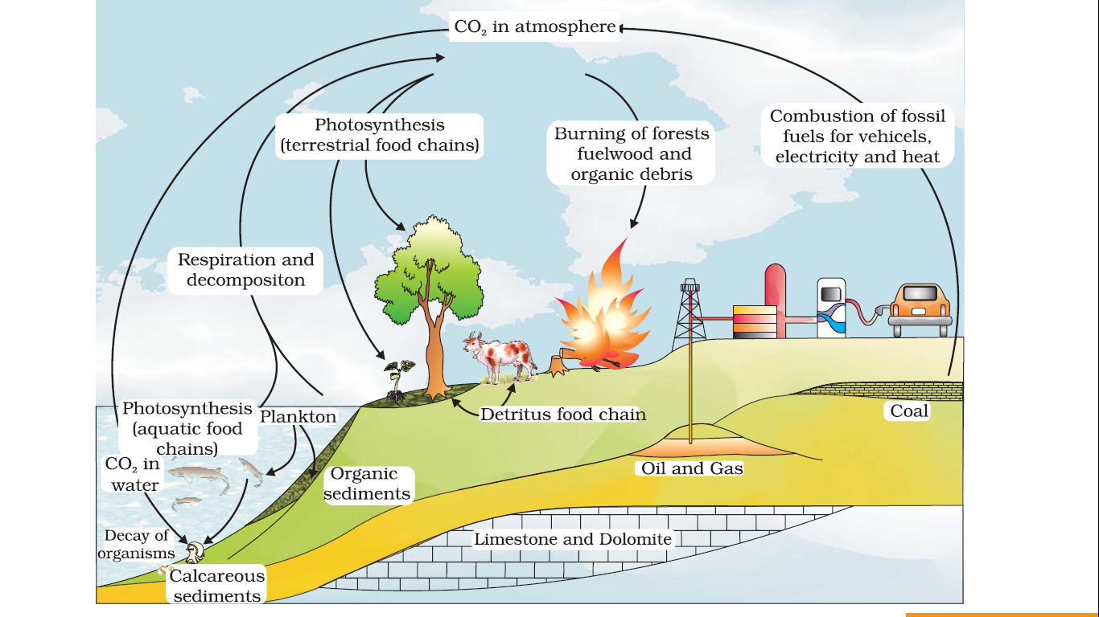
Figure Simplified model of carbon cycle in the biosphere
Carbon cycling occurs through atmosphere, ocean and through living and dead organisms

Slide 42
Carbon Cycle
Carbon constitutes 49% of dry weight of organisms.
71% carbon is found dissolved in oceans which regulates the amount of carbon dioxide in the atmosphere.
Atmosphere contains 1% of total global carbon
Fossil fuel also represent a reservoir of carbon.
It was estimated that 4 × 10¹³ kg of carbon is fixed in the biosphere through photosynthesis annually.
A considerable amount of carbon returns to the atmosphere as CO₂ through respiratory activities of the producers and consumers.
Decomposers also contribute substantially to CO₂ pool by their processing of waste materials and dead organic matter of land or oceans.

Slide 43
Carbon Cycle
Some amount of the fixed carbon is lost to sediments and removed from circulation.
CO₂ is released in the atmosphere by burning of wood, forest fire and combustion of organic matter, fossil fuel, volcanic activity.
Human activities like rapid deforestation and massive burning of fossil fuel for energy and transport have significantly increased the rate of release of carbon dioxide into the atmosphere.

Slide 44
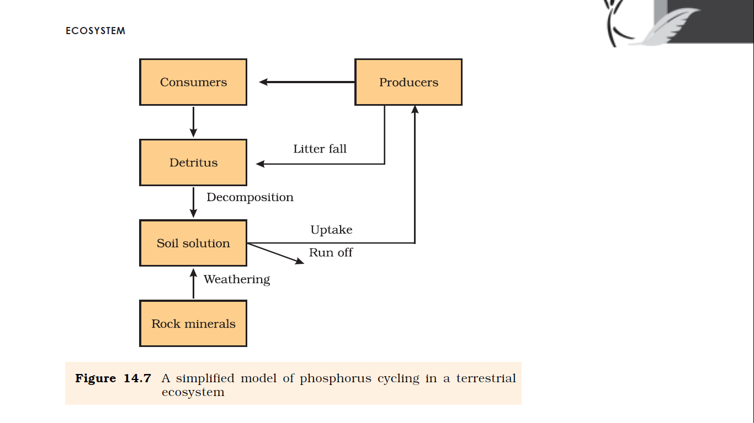
Figure A simplified model of phosphorus cycling in a terrestrial ecosystem
(Phosphate solubilising bacteria)

Slide 45
Ecosystem – Phosphorus Cycle
Phosphorus is a major constituent of biological membranes, nucleic acids and cellular energy transfer systems.
Many animals also need large quantities of phosphorus to make shells, bones and teeth.
The natural reservoir of phosphorus is rock, which contains phosphorus in the form of phosphates.
When rocks are weathered, minute amounts of these phosphates dissolve in soil solution and are absorbed by the roots of the plants.
Herbivores and other animals obtain this element from plants.
The waste products and the dead organisms are decomposed by phosphate-solubilising bacteria releasing phosphorus.

Slide 46
Ecosystem – Phosphorus Cycle
Differentiate between the carbon and the phosphorus cycle?
Phosphorus | Carbon
Atmospheric inputs of phosphorus through rainfall are much smaller than carbon inputs | Atmospheric inputs of carbon through rainfall are much larger than phosphorus inputs
Gaseous exchanges of phosphorus between organism and environment are negligible i.e. No respiratory release of phosphorus into atmosphere | Large amount of carbon in the form of gaseous state is exchanged between organism and environment i.e. Large amount of carbon is released as respiratory release into atmosphere

Slide 47
ECOSYSTEM SERVICES
Healthy ecosystems are the base for a wide range of economic, environmental and aesthetic goods and services.
The products of ecosystem processes are named as ecosystem services
Healthy forest ecosystem services;
purify air and water,
mitigate droughts and floods,
cycle nutrients,
generate fertile soils,
provide wildlife habitat,
maintain biodiversity,
pollinate crops,
provide storage site for carbon and
provide aesthetic, cultural and spiritual values.

Slide 48
Value of ecosystem services
Value of ecosystem services of biodiversity is difficult to determine
Robert Constanza and his colleagues have very recently tried to put price tags on nature’s life support services, which came up to average of US $ 33 trillion a year
Ecosystem services | Cost of various ecosystem services in percentage
Soil formation | 50%
Recreation | <10%
Nutrient cycling | <10%
Climate regulation | 6%
Habitat for wildlife | 6%
Notes:
Out of the total cost of various ecosystem services, the soil formation accounts for about 50 per cent, and contributions of other services like recreation and nutrient cycling, are less than 10 per cent each. The cost of climate regulation and habitat for wildlife are about 6 per cent each.

Slide 49
Chapter ends here.....

Slide 50
Succession of Plants on rocks
In primary succession on rocks these are usually lichens which are able to secrete acids to dissolve rock, helping in weathering and soil formation.
These later pave way to some very small plants like bryophytes, which are able to take hold in the small amount of soil. They are, with time, succeeded by bigger plants, and after several more stages, ultimately a stable climax forest community is formed. The climax community remains stable as long as the environment remains unchanged. With time the xerophytic habitat gets converted into a mesophytic one.

Slide 51
Succession of Plants in water
In primary succession in water, the pioneers are the small phytoplanktons, they are replaced with time by free-floating angiosperms, then by rooted hydrophytes, sedges, grasses and finally the trees. The climax again would be a forest. With time the water body is converted into land.
In secondary succession the species that invade depend on the condition of the soil, availability of water, the environment as also the seeds or other propagules present. Since soil is already there, the rate of succession is much faster and hence, climax is also reached more quickly.
What is important to understand is that succession, particularly primary succession, is a very slow process, taking maybe thousands of years for the climax to be reached. Another important fact is to understand that all succession whether taking place in water or on land, proceeds to a similar climax community – the mesic.

